Slide 1

Fingerprint Based Authentication System
Supervised by
Md. Akkas Ali
Assistant Professor & Chairman
Dept. of CSE,BSMRSTU.
Presented by
Arun Biswas
20121201047
Dept. of CSE,BSMRSTU.

Slide 2
Contents
Objectives
What is Fingerprint ?
Methodology
Result And Discussion

Slide 3
Objectives
To increase the image quality .
Verification and Identification.
To establish a better security system.
To get a better accuracy .
To keep data in database as byte stream .

Slide 4
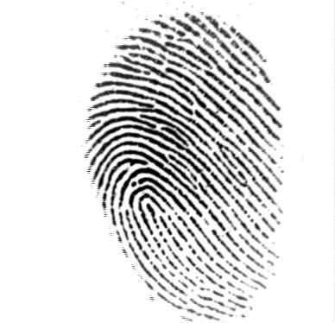
What is fingerprint ?
A fingerprint is the feature pattern of one finger.
Fig . A fingerprint image

Slide 5
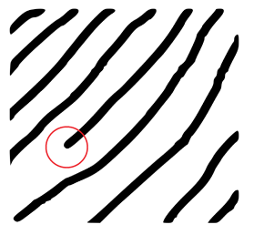
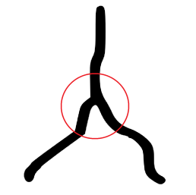
What is fingerprint ? cont...
The two most prominent local ridge characteristics, called minutiae, are 1) ridge ending and 2) ridge bifurcation.
ridge ending
bifurcation
Fig . Minutiae.

Slide 6
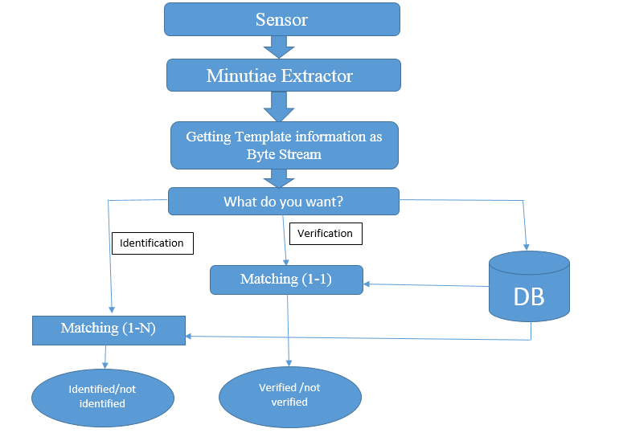
Methodology

Slide 7
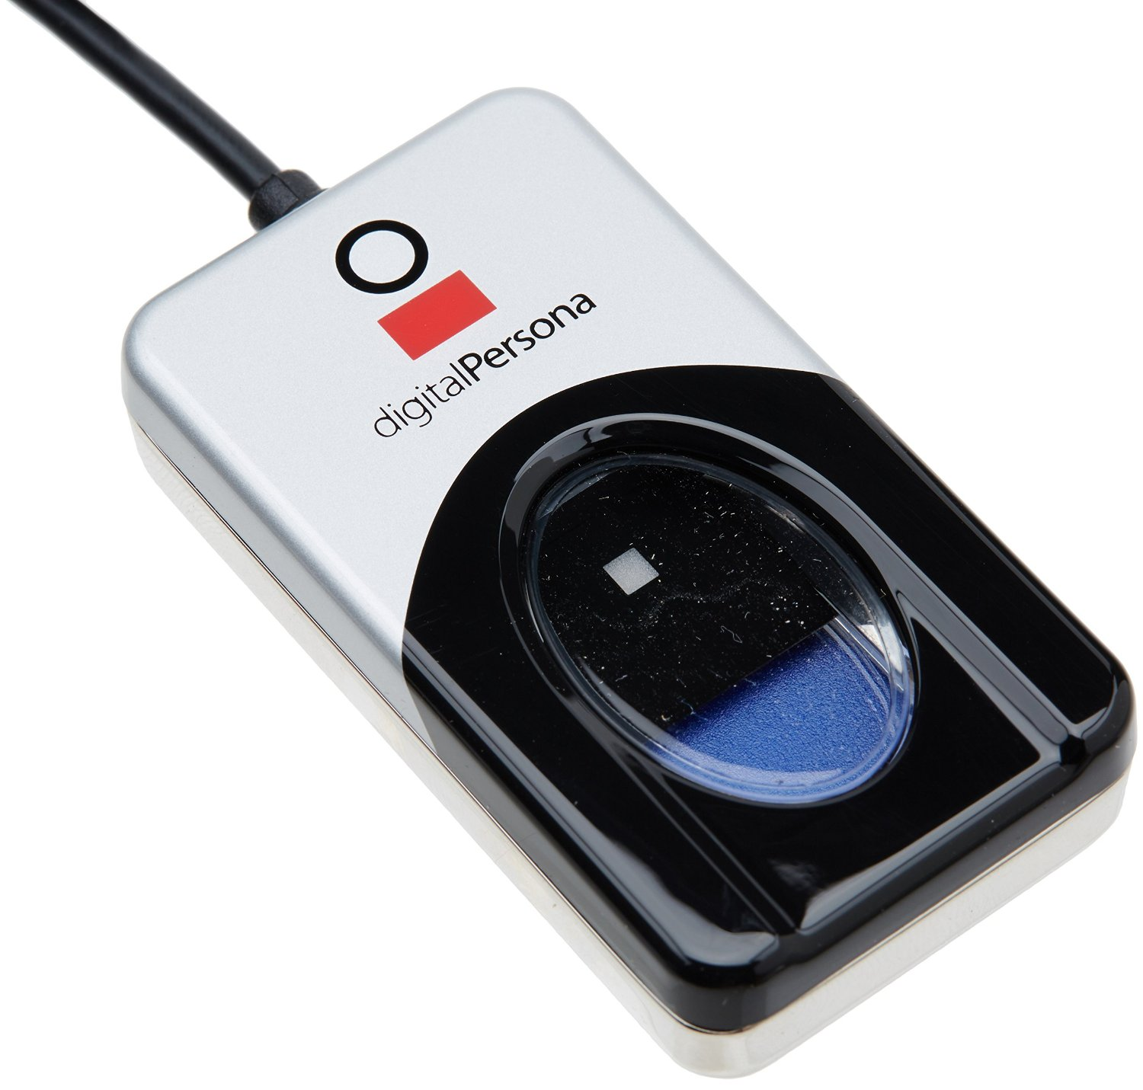
Methodology cont...
A fingerprint scanner an electronic device used to capture a digital image of the fingerprint pattern.

Slide 8
Methodology cont...
Minutiae Extractor
Image Enhancement
Image Binarization
Pre-processing
Minutia extraction
Thinning
Minutiae Marking
Post-processing
Remove False Minutiae

Slide 9
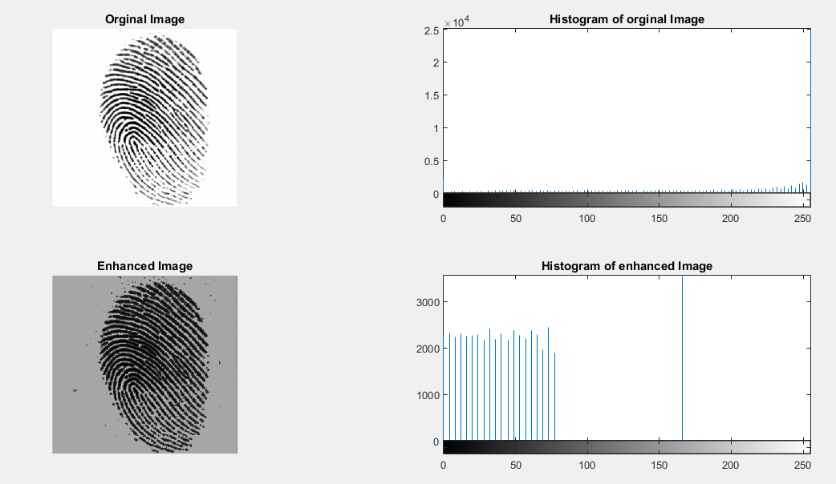
Methodology cont...
Histogram equalization
Histogram equalization is mainly used to increase the pixel value of an image .

Slide 10

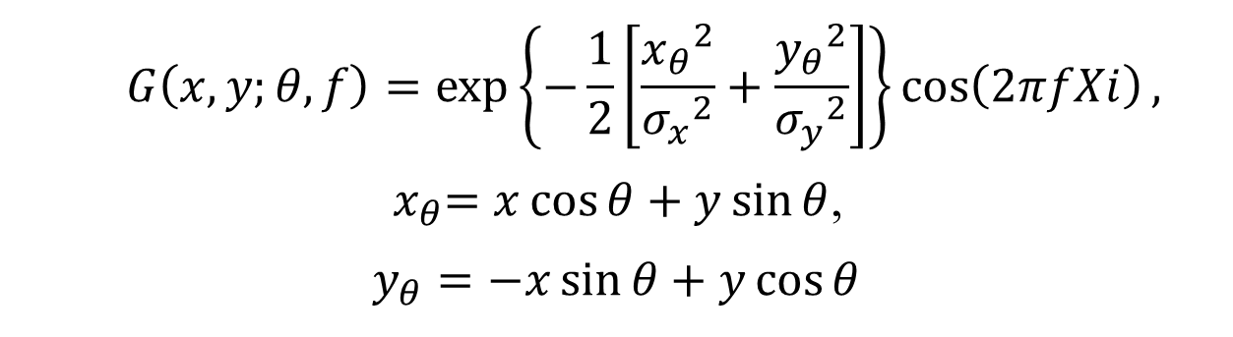
Methodology cont...
Gabor filtering
Gabor filtering is done by the following formula:
$$G\left(x,y;θ,f\right)=\exp\left\{−\frac{1}{2}\left[\frac{{x_{θ}}^{2}}{{σ_{x}}^{2}}+\frac{{y_{θ}}^{2}}{{σ_{y}}^{2}}\right]\right\}\cos\left(2πfXi\right),$$
${ x}_{θ}=x\cos{θ+y\sin{θ}}$,
$$y_{θ}=−x\sin{θ}+y\cos{θ}$$
Figure: Image Enhancement by Gabor filtering

Slide 11
Methodology cont...
Image Binarization
0 | 0 | 0 | 0 | 0 | 0 | 0 | 0 | 0 | 1
0 | 0 | 0 | 0 | 0 | 0 | 0 | 0 | 1 | 0
0 | 1 | 1 | 1 | 1 | 1 | 1 | 1 | 0 | 0
0 | 0 | 0 | 0 | 0 | 0 | 0 | 0 | 1 | 0
0 | 0 | 0 | 0 | 0 | 0 | 0 | 0 | 0 | 1
0 | 1 | 0 | 0 | 0 | 0 | 1 | 0 | 0 | 0
calculate the average of rgb color values from a cell;
if(average > 127) then the cell is 1;
else cell is 0;

Slide 12
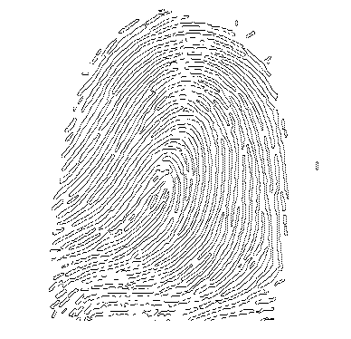
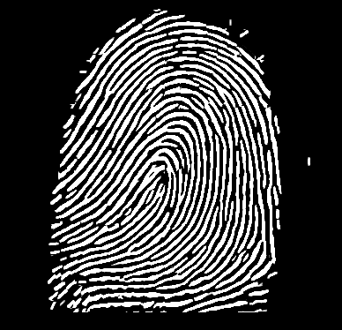
Methodology cont...
Thinning
Fig : After thinning
Fig : Before thinning

Slide 13
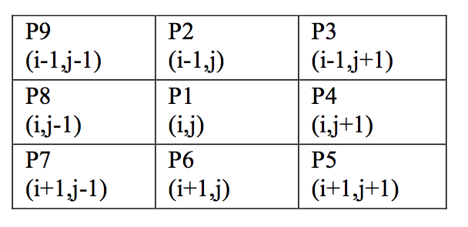
Methodology cont...
Thinning..
Image thinning is used to reduce the darkness of all ridge lines.
B = P 2 + P 3 + P 4 + P 5 + P 6 + P 7 + P 8 + P 9
A(P1)= 1; center point must be Black/1 itself !
if(A == 1&&3 <= B <= 6) then center cell color is 1
else color is 0

Slide 14
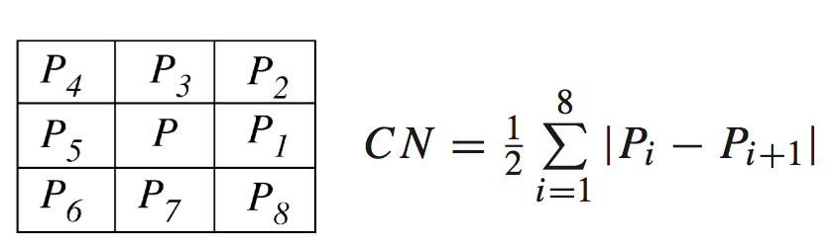
Methodology cont...
Minutiae Marking
The concept of Crossing Number (CN) is widely used for extracting the minutiae

Slide 15
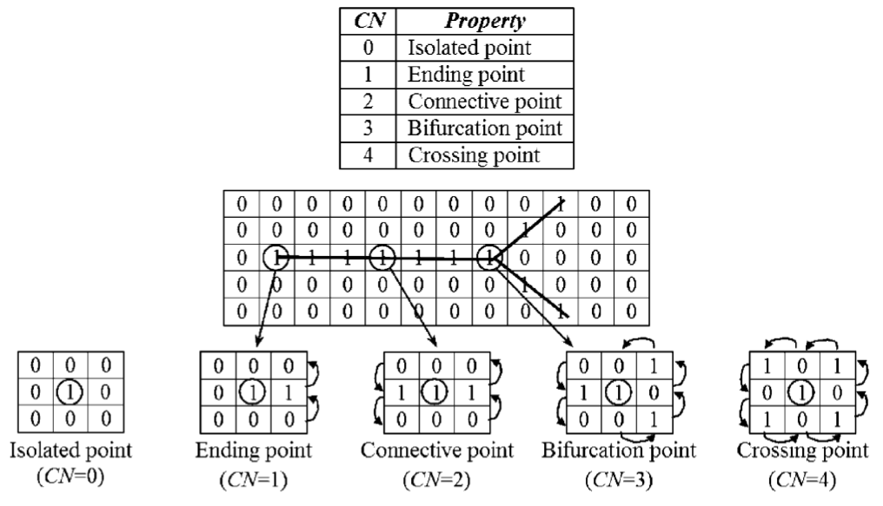
Methodology cont...
Minutiae Marking..

Slide 16
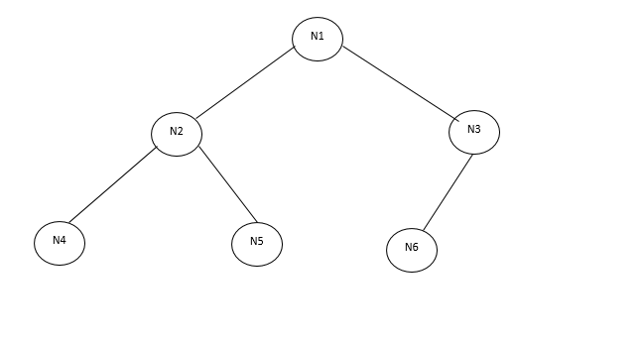

Methodology cont...
Getting information from Fingerprint using Heap algorithm
N is the nodes
d is the distance
d
d
Euclidean distance

Slide 17
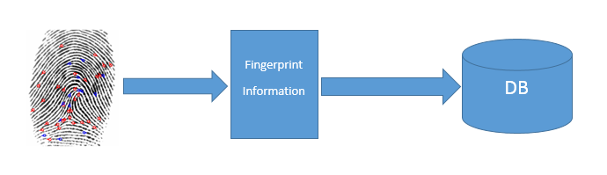
Methodology cont...
Fig: Keeping information in database

Slide 18
Methodology cont...
Fingerprint Matching
d
d

Slide 19
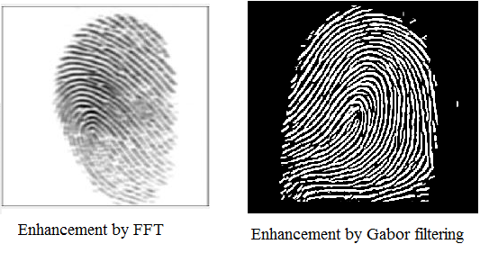
Result And Discussion
Fig: FFT enhancement and Gabor filter enhancement

Slide 20
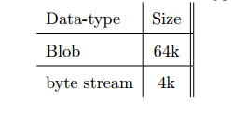
Result And Discussion cont...
Table : Difference of data-type

Slide 21
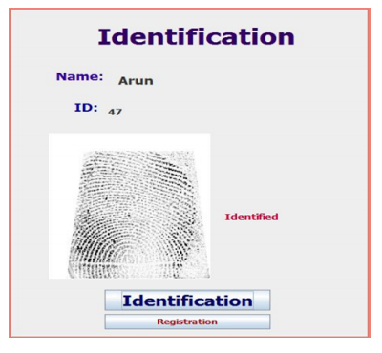
Result And Discussion cont...
Identification(1-N)

Slide 22
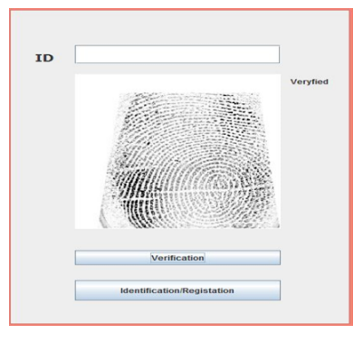
Result And Discussion cont...
Verification(1-1)

Slide 23
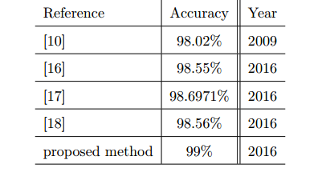
Result And Discussion cont...
Accuracy

Slide 24
Thank You

